Slide 1


Social Buzz

Slide 2


Today's agenda
Project recap
Problem
The Analytics team
Process
Insights
Summary

Slide 3

Social Buzz is a fast growing and a major social media company emphasizes anonymous user interactions with content. Accenture has begun a 3 month POC focusing on below tasks:
Auditing their current big data practices.
Providing recommendations to ensure a smooth IPO.
Offer insights and strategies for managing their massive data sets using industry best practices.
Highlight the most popular content categories to optimize user engagement and platform performance.
Project Recap

Slide 4

Problem
Over 500 million monthly active users in the past five years.
100,000 pieces of content posted daily.
How to capitalize on it when there is so much?
Analysis to find Social Buzz’s top 5 most popular categories of contents.

Slide 5



Tamanna Sharma
(Data Analyst)
The Analytics team
Andrew Fleming (Chief Technical Architect)
Marcus Rompton (Senior Principle)

Slide 6
Process
1
Data Understanding
2
Data Cleaning
3
Data Modeling
4
Data Analysis
Uncover Insights
5

Slide 7

Insights
16
Unique Categories
Animals: 1,897
Healthy Eating: 1,717
Science: 1,796
Technology: 1,698
Travel: 1,647
1897
Reactions to “Animal” Posts
May
Month with most posts

Slide 8
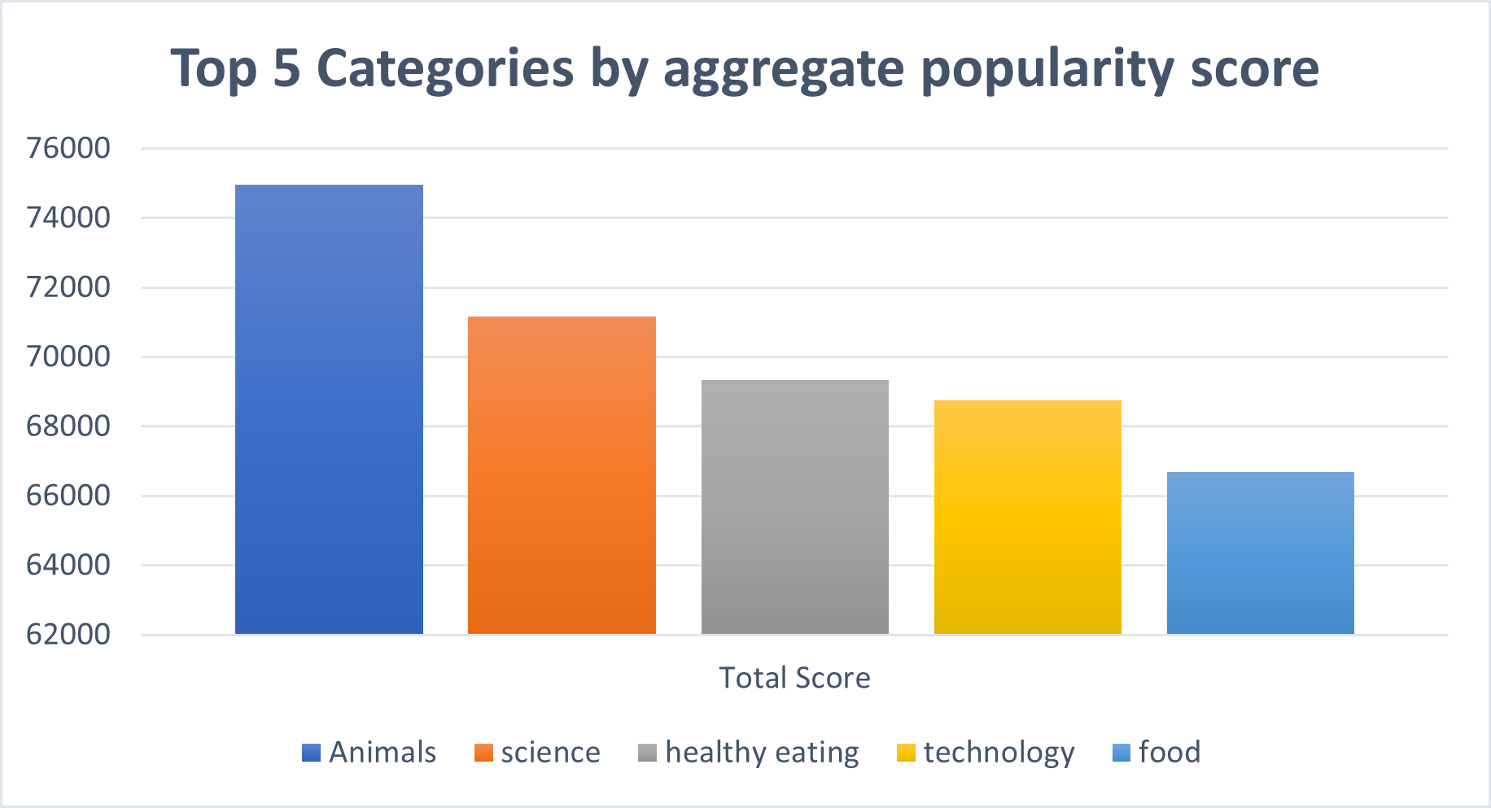

Slide 9
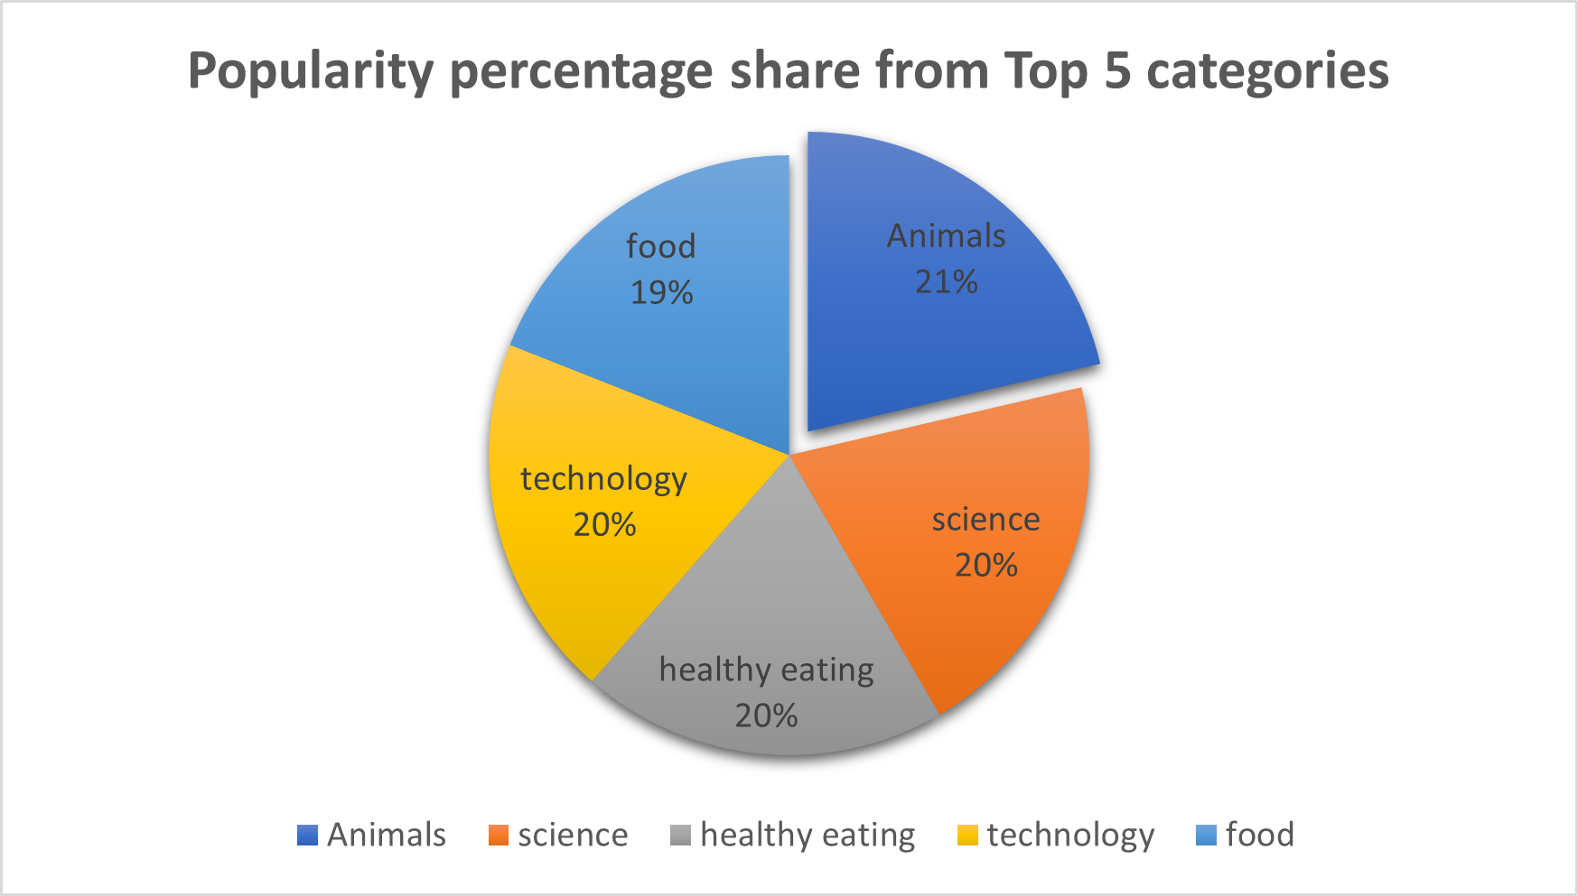

Slide 10

ANALYSIS
Animals and science are the two most popular categories of content, showing that people enjoy "real-life" and "factual" content the most.
INSIGHT
Food is a common theme with the top 5 categories with "Healthy Eating" ranking the highest. This may give an indication to the audience within your user base. You could use this insight to create a campaign and work with healthy eating brands to boost user engagement.
NEXT STEPS
This ad-hoc analysis is insightful, but it's time to take this analysis into large scale production for real-time understanding of your business. We can show you how to do this.
Summary

Slide 11
Thank you!
ANY QUESTIONS?

